Slide 1

Graduation Project Presentation
Students:
Mohamed Sawy
Mohamed Ramadan
Sara Abdulakher
Mohammed Nagar
Mahmoud Fathy
Track: Odoo Application Consultant
Supervisor Name: Diaa Hamdan

Slide 2
Introduction
Overview of the project
Objectives and goals

Slide 3

Project Scope
This project aims to implement an Odoo ERP system to streamline and automate various business processes within Compu-Assembly company

Slide 4


Slide 5
Business Cycle
Procurement and Import Process
Storage and Inventory Management
Sales and Marketing
Distribution and Export
Customer Service and After-Sales Support
Accounting and Financial Reporting

Slide 6

Implementation
1 – Purchase:
Request for Quotation (RFQ): A quotation is requested from a supplier.
Purchase Order (PO): Once the RFQ is accepted, it converts to a PO.
Approval: The PO is approved by authorized personnel.

Slide 7

Implementation
2 – Inventory:
Inventory refers to all the items, goods, merchandise, and materials held by a business for selling in the market to earn a profit.

Slide 8
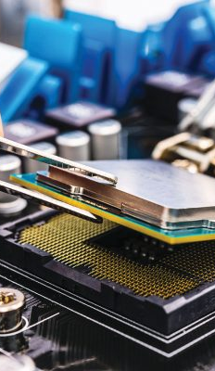
Implementation
3- Manufacturing:
BoM Creation: Define the components needed for assembly.
Manufacturing Order (MO): Issue an order to assemble the product.
Stock Check and Planning: Verify component availability.
Executing the MO: Assemble the components into the final product.
Confirm Completion: Update inventory with the final product and deduct components.

Slide 9

Implementation
4- Sales:
Lead Generation: Identify potential customers. Opportunity Creation: Convert
-leads into opportunities. Quotation Creation: Create and send quotations.
-Quotation Approval: Negotiate and finalize the quotation.
-Sales Order Creation: Convert quotations into sales orders.
-Product Delivery: Prepare and deliver products to customers.
-Invoicing: Generate invoices based on sales orders.
-Payment Processing: Receive and track payments.
-Customer Follow-Up: Engage with customers post-sale.
Reporting and Analysis: Analyze sales data for improvements.

Slide 10
Conclusion
Summary of achievements
Reflection on impact
Final remarks

Slide 11
Acknowledgments
Thank supervisors, team members.

Slide 12
Questions
Invite questions from the audience

